Slide 1

Moments Coherent-State Quantum Process Tomography (McsQPT)
Masoud Ghalaii
Nov. 2013
Joint work with: S. Rahimi-Keshari, A. T. Rezakhani, T. C. Ralph

Slide 2
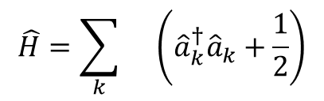
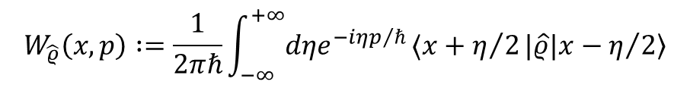




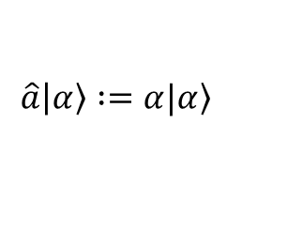
Basic concepts—Phase space, Wigner function, HD, …
Harmonic oscillator
Annihilation and creation operators
Phase space
$$\hat{H}=\sum_{k}{}\left({\hat{a}}_{k}^{†}{\hat{a}}_{k}+\frac{1}{2}\right)$$
$$\hat{a}|α〉 :=α|α〉$$
$$\overline{p}$$
Wigner function
$$α$$
$$W_{\hat{ρ}}\left(x,p\right) :=\frac{1}{2πℏ}\int_{−∞}^{+∞}{dηe^{−iηp/ℏ}}〈x+η/2|\hat{ρ}|x−η/2〉$$
$$\overline{x}$$
$α=\overline{x}$+i$\overline{p}$
Leonhardth, Measuring the Quantum State of Light (1997)
Garrison and Chiao, Quantum Optics (2008)

Slide 3
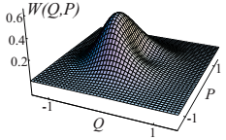
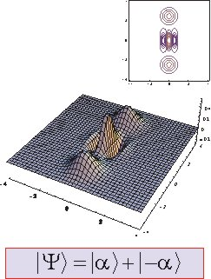
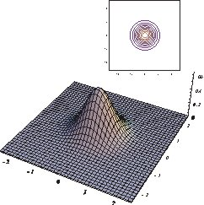
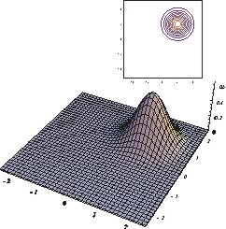
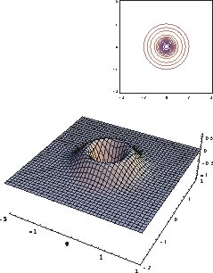
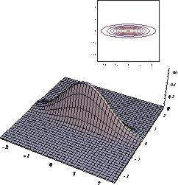
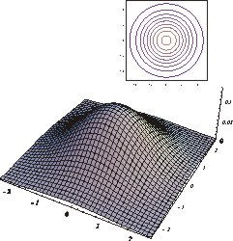
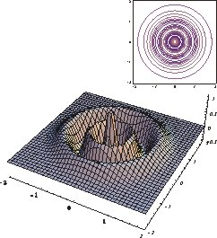

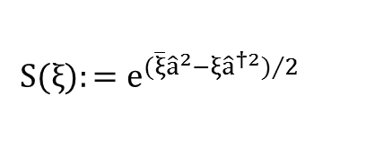
Some foremost quantum states—Alex Lvovsky laboratory
$$D\left(α\right)|0〉=|α〉$$
$${D\left(α\right)=e}^{αa^{†}−\overline{α}a}$$
Smithy, et al. –PRL (1992)
$$S(ξ):=e^{(\overline{ξ}{\hat{a}}^{2}−ξ{\hat{a}}^{†2})/2}$$

Slide 4
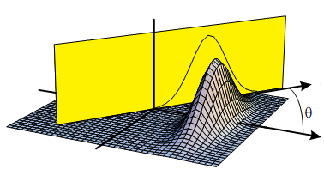
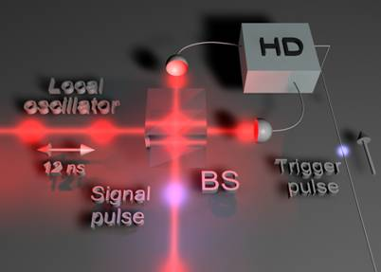
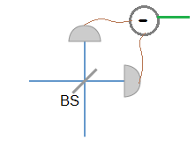




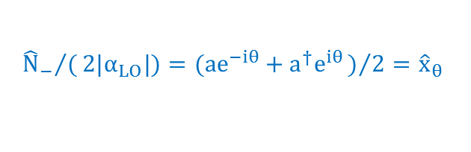


Basic concepts—Homodyne detection, state tomography, …
[Balanced] homodyne detection
$$W_{\hat{ρ}}\left(x,p\right)$$
$${{\hat{N}}_{−}}/(2|α_{LO}|)=(ae^{−iθ}+a^{†}e^{iθ})/2={\hat{x}}_{θ}$$
$$N_{−}$$
$${\overline{x}}_{θ}$$
$$α_{LO}$$
$$\overline{p}$$
$$\overline{x}$$
Characteristic function
$χ\left[\hat{ϱ}\right]\left(ξ\right) :=\text{Tr} \left[\hat{ϱ}D\left(ξ\right)\right],{ D\left(ξ\right)=e}^{ξa^{†}−\overline{ξ}a}$; $D\left(α\right)|0〉=|α〉$
Lvovsky and Raymer –RMP (2009)
Cahil and Glauber –Phys.Rev. (1969)

Slide 5
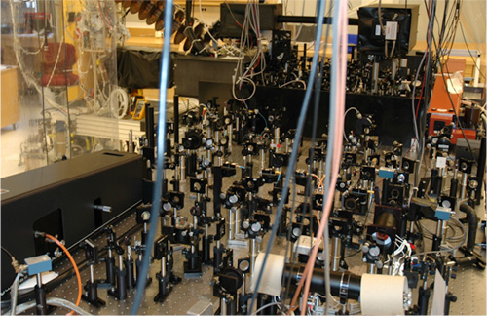
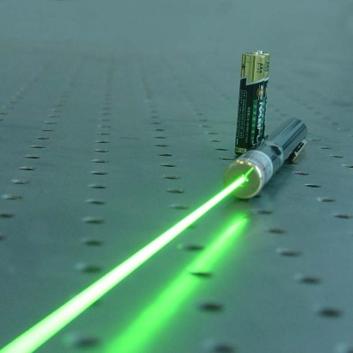

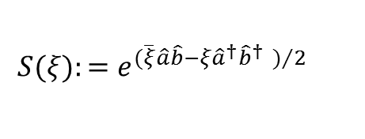



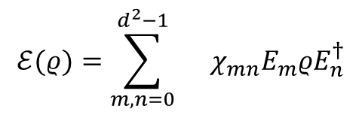

Quantum [optical] process tomography
A general dynamical map
Quantum process tomography
Two-mode squeezed vacuum
Coherent-state Quantum Process Tomography
Mohseni, Rezakhani, and Lidar –PRA (2008)
D’Ariano and Lo Presti –PRL (2001)
Lobino, et al. –Science (2008)
$$ℰ(ρ)=\sum_{i}{}A_{i}ρA_{i}^{†}$$
$$S(ξ):=e^{(\overline{ξ}\hat{a}\hat{b}−ξ{\hat{a}}^{†}{\hat{b}}^{†} )/2}$$
A set of fixed Hermitian operators
Readily available in lab
Could be produce in many amplitudes and phases
Characterization of outputs by using HD
$${\left\{E_{i}\right\}}_{i=0}^{d^{2}−1}$$
$$A_{i}=\sum_{m=0}^{d^{2}−1}{}a_{mi}E_{m}$$
$$\text{Tr} \left(E_{i}^{†}E_{j}\right)=dδ_{ij}$$
$$ℰ(ρ)=\sum_{m,n=0}^{d^{2}−1}{}χ_{mn}E_{m}ρE_{n}^{†}$$
$$χ_{mn}=\sum_{i,j}{}a_{mi}a_{nj}^{∗}$$
Notes:
(i) coherent states are readily available from lasers,
(ii) coherent states of different amplitudes and phases can be produced without changing the layout of the experimental apparatus
(iii) output-state characterization can be performed using optical homodyne tomography
TMSV→QPT can be performed with two-mode squeezed vacuum (TMSV) for any unknown process. However, TMSVs are not so easy to manipulate in
practice, especially because this involves quantum tomography of entangled states

Slide 6
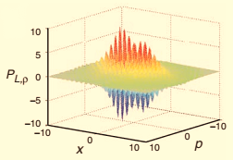
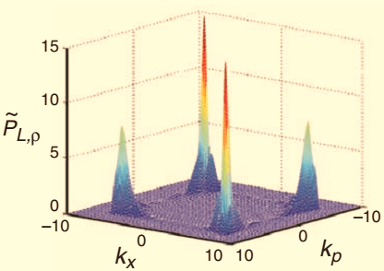
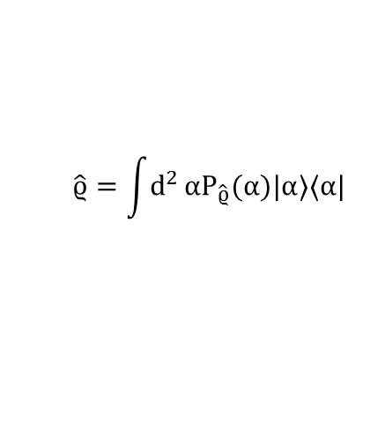
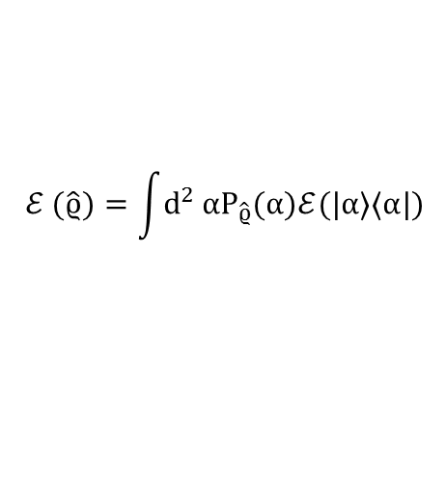
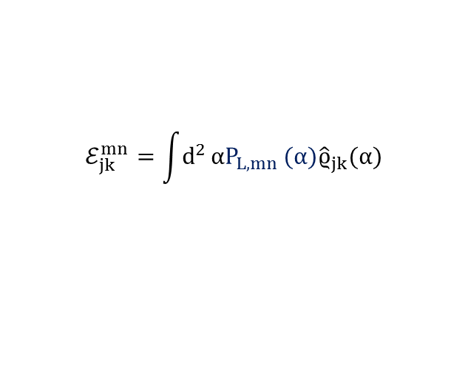
Coherent-state quantum process tomography (csQPT)
Glauber-Sudarshan Representation
Sudarshan –PRL (1963) || Glauber –PRL (1963)
Lobino, et al. –Science (2008)
Introductory Quantum Optics, Gerry and Knight (2005)
$$\hat{ϱ}=\int{d^{2}}αP_{\hat{ϱ}}(α)|α〉〈α|$$
$$ℰ (\hat{ϱ})=\int{d^{2}}αP_{\hat{ϱ}}(α)ℰ(|α〉〈α|)$$
$$ℰ_{jk}^{mn}=\int{d^{2}}αP_{L,mn }(α){\hat{ϱ}}_{jk}(α)$$
Notes:
P function for many non-classical
P- FUNCTION --optical states exists only in terms of a highly singular → LOBINO: regularizing P-function

Slide 7





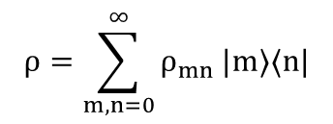
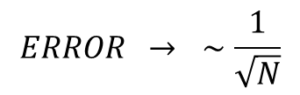
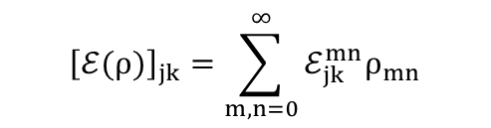
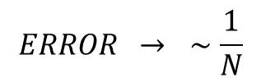

csQPT in Fock basis
$$\overline{p}$$
$$ρ=\sum_{m,n=0}^{∞}{ρ_{mn}}|m〉〈n|$$
$${\left\{|n〉\right\}}_{n=0}^{∞}$$
$${\left[ℰ(ρ)\right]}_{jk}=\sum_{m,n=0}^{∞}{ℰ_{jk}^{mn}ρ_{mn}}$$
$$\overline{x}$$
$$ℰ_{jk}^{mn}=\frac{1}{\sqrt{m!n!}}∂_{α}^{m}∂_{\overline{α}}^{n}{\left[e^{|α|^{2}}〈j|ℰ(|α〉〈α|)|k〉\right]}_{α=0}$$
$$|α〉$$
$$ℰ(|α〉〈α|)$$
$$ERROR → ∼\frac{1}{\sqrt{N}}$$
$$ℰ$$
Rahimi-Keshari, et al. –NJP (2011)
$$ERROR → ∼\frac{1}{N}$$

Slide 8

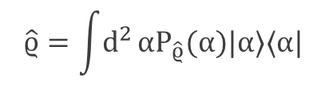


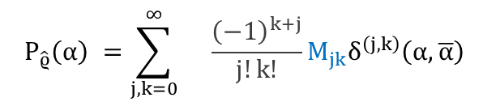
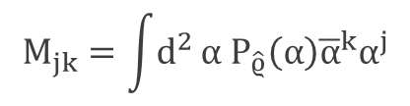
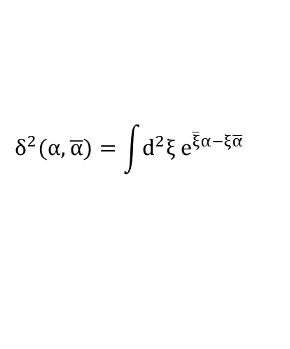
Normally-ordered moments—Definition
$$M_{jk}≔\text{Tr} [{\hat{ρ} a}^{†k}a^{j}]$$
$$M_{j_{1}k_{1}j_{2}k_{2}}≔\text{Tr} [{\hat{ρ}a^{†k_{1}}a^{j_{1}}b}^{†k_{2}}b^{j_{2}}]$$
$$M_{jk}=\int{d^{2}}α{ P}_{\hat{ϱ}}\left(α\right){\overline{α}}^{k}α^{j}$$
$$\hat{ϱ}=\int{d^{2}}αP_{\hat{ϱ}}(α)|α〉〈α|$$
New method:
M-CS-QPT
$${ P}_{\hat{ϱ}}\left(α\right) =\sum_{j,k=0}^{∞}{}{\frac{{\left(−1\right)}^{k+j}}{j!k!}M}_{jk}δ^{\left(j,k\right)}\left(α,\overline{α}\right)$$
$$δ^{\left(j,k\right)}(α,\overline{α})=∂_{α}^{j}∂_{\overline{α}}^{k} δ^{2}(α,\overline{α})$$
C. T. Lee –PRA (1992)
$$δ^{2}(α,\overline{α})=\int{d^{2}ξ{ \text{e}}^{\overline{ξ}α−ξ\overline{α}}}$$

Slide 9
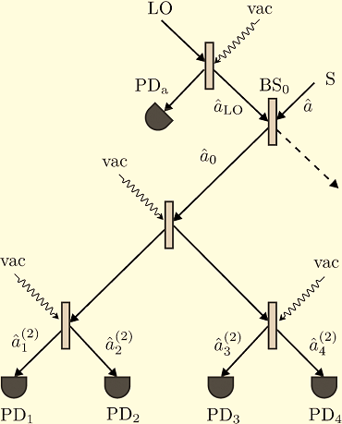
csQPT by using moments—motivations
Prediction of non-classicality of process
Characterization of Gaussian processes
Direct measurement of moments
Shchukin and Vogel –PRA (2005)
Rahimi-Keshari, et al. –PRL (2013)
Some Gaussian processes
Amplification
Attenuation
Squeezing
Displacement
Thermalization
Identity
. . .
Definition: A quantum process is nonclassical if it transforms an input coherent state to a nonclassical state.

Slide 10
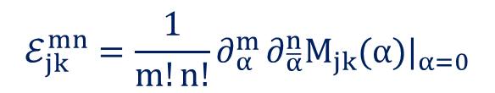
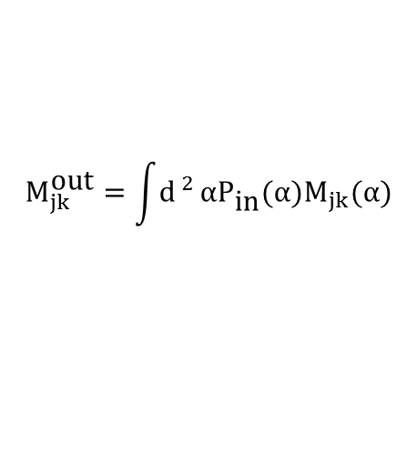
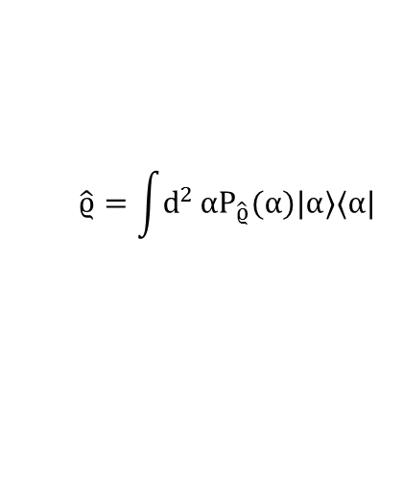


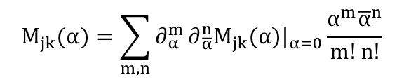
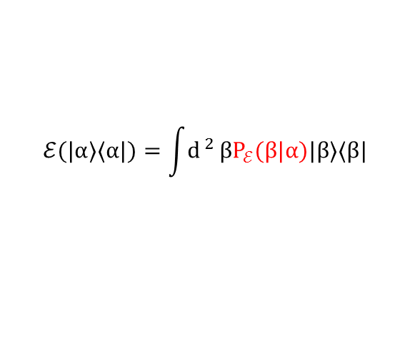

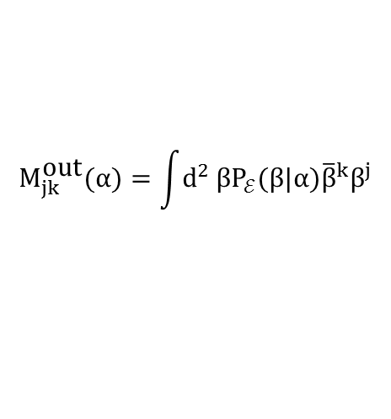
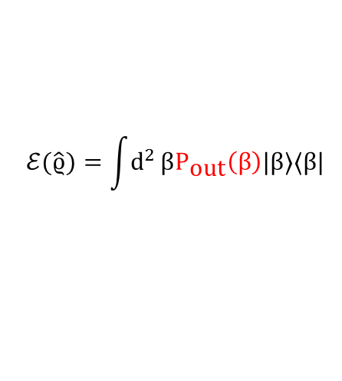
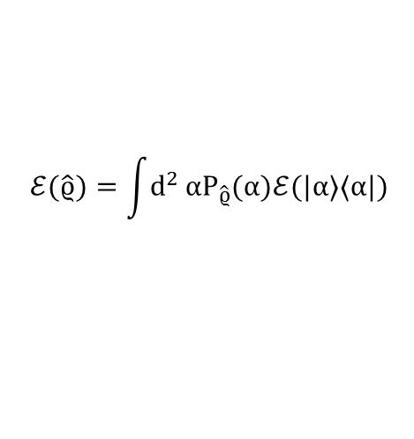

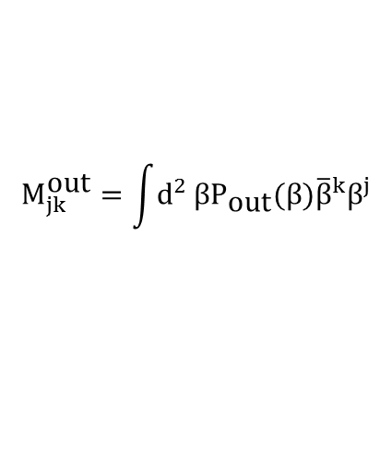
csQPT by using moments—Formalism
$$\hat{ϱ}=\int{d^{2}}αP_{\hat{ϱ}}(α)|α〉〈α|$$
$$ℰ$$
$$ℰ(\hat{ϱ})=\int{d^{2}}αP_{\hat{ϱ}}(α)ℰ(|α〉〈α|)$$
Scratch paper!
$$P_{\text{out}}(β)=\int{{\text{d}}^{ 2}}αP_{\text{in}}(α)P_{ℰ}(β|α)$$
$$×{\overline{β}}^{k}β^{j}$$
$$M_{jk}^{\text{out}}=\int{{\text{d}}^{ 2}}αP_{\text{in}}(α)M_{jk}(α)$$
$$ℰ(\hat{ϱ})=\int{d^{2}}βP_{\text{out}}\left(β\right)|β〉〈β|$$
$$ℰ(|α〉〈α|)=\int{{\text{d}}^{ 2}}βP_{ℰ}(β|α)|β〉〈β|$$
$$M_{jk}(α)=\sum_{m,n}{∂_{α}^{m}}∂_{\overline{α}}^{n}M_{jk}(α)|_{α=0}\frac{α^{m}{\overline{α}}^{n}}{m!n!}$$
$$M_{jk}^{\text{out}}=\int{{\text{d}}^{2}}βP_{\text{out}}(β){\overline{β}}^{k}β^{j}$$
$$M_{jk}^{\text{out}}=\sum_{m,n}{ℰ_{jk}^{mn}}M_{mn}^{\text{in}}$$
$$M_{jk}^{\text{out}}(α)=\int{{\text{d}}^{2}}βP_{ℰ}(β|α){\overline{β}}^{k}β^{j}$$
$$ℰ_{jk}^{mn}=\frac{1}{m!n!}∂_{α}^{m}∂_{\overline{α}}^{n}M_{jk}(α)|_{α=0}$$
Notes:
\times \bar{\beta}^k \beta^j

Slide 11
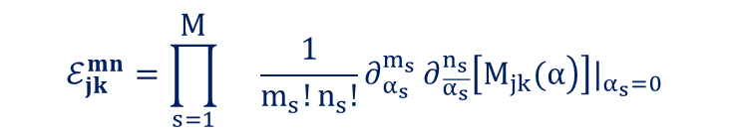



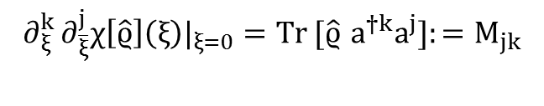





McsQPT—Formalism
McsQPT—Formalism—Generalization (M-mode case)
Some multi-mode processes
- Beam splitter
- Squeezers
- Noises and loses
- Entanglement-based protocols for Quantum Key Distribution (QKD) and Quantum Secret Sharing
- Evolution of highly entangled multimode state, known as a cluster state
$$ℰ_{jk}^{mn}=\frac{1}{m!n!}∂_{α}^{m}∂_{\overline{α}}^{n}M_{jk}(α)|_{α=0}$$
$$ℰ_{jk}^{mn}=\prod_{s=1}^{\text{M}}{}\frac{1}{m_{s}!n_{s}!}∂_{α_{s}}^{m_{s}}∂_{\overline{α_{s}}}^{n_{s}}\left[\left.M_{jk}(α\right)\right]|_{α_{s}=0}$$
$$χ\left[\hat{ϱ}\right]\left(ξ\right) :=\text{Tr} [\hat{ϱ}e^{ξa^{†}−\overline{ξ}a}]$$
$$\left(n) :=(n_{1},n_{2},…,n_{M}\right)$$
$$\left(m) :=(m_{1},m_{2},…,m_{M}\right)$$
$$∂_{ξ}^{k}∂_{\overline{ξ}}^{j}χ\left[\hat{ϱ}\right]\left(ξ\right)|_{ξ=0}=\text{Tr} [{\hat{ϱ} a}^{†k}a^{j}]{:=M}_{jk}$$
$$\left(j) :=(j,j_{2},…,j_{M}\right)$$
$$\left(k) :=(k_{1},k_{2},…,k_{M}\right)$$
$$ℰ_{jk}^{mn}=\frac{{\left(−1\right)}^{j}}{m!n!}∂_{α}^{m}∂_{\overline{α}}^{n}∂_{ξ}^{k}∂_{\overline{ξ}}^{j}χ_{ℰ}(ξ|α)|_{α,ξ=0}$$
$$|α〉 :=|α_{1},α_{2},…,α_{M}〉$$
Adesso and Illuminati –arxiv (2005)

Slide 12

McsQPT—Other examples …

Slide 13




McsQPT—Gaussian processes—Gaussian states
$$𝓦\left[ϱ_{G}\right]\left(R\right) :=\frac{1}{{\left(2π\right)}^{n}\sqrt{\left.\text{Det} [V\right]}}\text{exp}\left(−\frac{1}{2}{\left(R−\overline{R}\right)}^{\text{T}}V_{}^{−1}(R−\overline{R})\right)$$
Gaussian states
Mean value vector
Covariance matrix
Single-mode Gaussian state
Ferarro, et al. –arXiv (2005) || Adesso and Illuminati –J.Phys.A. (2007)
$$\overline{R} :={\left({\overline{R}}_{1} {\overline{R}}_{2} ... {\overline{R}}_{2N}\right)}^{T}$$
$${\left[V\right]}_{jk} :=\frac{1}{2}〈{\hat{R}}_{j}{\hat{R}}_{k}+{\hat{R}}_{k}{\hat{R}}_{j}〉−〈{\hat{R}}_{j}〉〈{\hat{R}}_{k}〉$$
$$\left.\overline{𝒜}≡〈\hat{𝒜}〉=\text{Tr} [\hat{𝒜}ϱ_{G}\right]$$
$$𝒲[ρ_{G}](x,p)=\frac{1}{2π\sqrt{\left.\text{Det}[V\right]}}exp\left(\frac{\left.−Δ_{pp}{\left(x−\overline{x}\right)}^{2}−Δ_{xx}{\left(p−\overline{p}\right)}^{2}+2Δ_{xp}(p−\overline{p})(x−\overline{x}\right)}{\left.2\text{Det}[V\right]}\right)$$
$$V=\left(\begin{matrix}Δ_{xx} & Δ_{xp} \\ Δ_{xp} & Δ_{pp}\end{matrix}\right)$$

Slide 14








McsQPT—Gaussian processes—Moments vs. R & V
$$M_{j_{1}k_{1}j_{2}k_{2}}=〈a^{†k_{1}}a^{j_{1}}b^{†k_{2}}b^{j_{2}}〉$$
$$M_{j_{1}k_{1}}=〈a^{†k_{1}}a^{j_{1}}〉$$
$$\begin{matrix}M_{1000}^{}=〈\hat{a}〉={\overline{x}}_{1}^{}+i{\overline{p}}_{1}^{} \\ M_{0010}^{}=〈\hat{b}〉={\overline{x}}_{2}^{}+i{\overline{p}}_{2}^{}\end{matrix}$$
$$M_{10}^{}=〈\hat{a}〉={\overline{x}}_{1}^{}+i{\overline{p}}_{1}^{}$$
$$M_{20}^{}=〈{\hat{a}}^{2}〉=(v_{11}^{}−v_{22}^{}+2iv_{12}^{})+M_{10}^{2}$$
$$\begin{matrix}M_{2000}^{}=〈{\hat{a}}^{2}〉=(v_{11}^{}−v_{22}^{}+2iv_{12}^{})+M_{1000}^{2} \\ M_{0020}^{}=〈{\hat{b}}^{2}〉=(v_{33}^{}−v_{44}^{}+2iv_{34}^{})+M_{0010}^{2}\end{matrix}$$
$$M_{11}^{}=〈{\hat{a}}^{†}\hat{a}〉=(v_{11}^{}+v_{22}^{}−1)+|M_{10}^{}|^{2}$$
$$\begin{matrix}M_{1100}^{}=〈{\hat{a}}^{†}\hat{a}〉=(v_{11}^{}+v_{22}^{}−1)+|M_{1000}^{}|^{2} \\ M_{0011}^{}=〈{\hat{b}}^{†}\hat{b}〉=(v_{33}^{}+v_{44}^{}−1)+|M_{0010}^{}|^{2}\end{matrix}$$
# of moments which completely characterize any M-mode Gaussian state is “M(M+2).”
$$\begin{matrix}M_{1010}^{}=〈\hat{a}\hat{b}〉=\left(v_{13}^{}−v_{24}^{}+iv_{14}^{}+iv_{23}^{}\right)+\left(〈{\hat{x}}_{1}〉〈{\hat{x}}_{2}〉−〈{\hat{p}}_{1}〉〈{\hat{p}}_{2}〉+i〈{\hat{x}}_{1}〉〈{\hat{p}}_{2}〉+i〈{\hat{p}}_{1}〉〈{\hat{x}}_{2}〉\right) \\ M_{1001}^{}=〈\hat{a}{\hat{b}}^{†}〉=\left(v_{13}^{}+v_{24}^{}−iv_{14}^{}+iv_{23}^{}\right)+\left(〈{\hat{x}}_{1}〉〈{\hat{x}}_{2}〉+〈{\hat{p}}_{1}〉〈{\hat{p}}_{2}〉−i〈{\hat{x}}_{1}〉〈{\hat{p}}_{2}〉+i〈{\hat{p}}_{1}〉〈{\hat{x}}_{2}〉\right)\end{matrix}$$

Slide 15














McsQPT—Gaussian processes—Number of resources
$$\overline{R^{′}}=T\overline{R}+d$$
$${\overline{R}′}_{i^{′}}^{\left(k\right)}={\text{t}}_{i^{′}j}{\overline{R}}_{j}^{\left(k\right)} j,k=1,...,2N+1$$
$T$, $N,d= ?$
$$V^{′}=TVT^{T}+N$$
$$\left\{\begin{matrix}{\overline{R}′}_{i^{′}}^{\left(1\right)}={\text{t}}_{i^{′}j}{\overline{R}}_{j}^{\left(1\right)} j=1,...,2N+1, \\ {\overline{R}′}_{i^{′}}^{\left(2\right)}={\text{t}}_{i^{′}j}{\overline{R}}_{j}^{\left(2\right)} j=1,...,2N+1, \\ . \\ . \\ . \\ {\overline{R}′}_{i^{′}}^{\left(2N+1\right)}={\text{t}}_{i^{′}j}{\overline{R}}_{j}^{\left(2N+1\right)} j=1,...,2N+1\end{matrix}\right.$$
$$\overline{R,} V$$
${\overline{R}}^{′},$ $V^{′}$
$T$, $N,d$
$${\overline{R^{′}}}_{i}={\text{t}}_{ij}{\overline{R}}_{j}+d_{i} i,j=1,...,2N$$
$$d_{i}≡{\text{t}}_{i,2N+1}$$
$${\overline{R}}_{2N+1}=1$$
$${\overline{R^{′}}}_{i}={\text{t}}_{ij}{\overline{R}}_{j} i=1,...,2N , j=1,...,2N+1$$
$${\overline{R^{′}}}_{i^{′}}^{\left(k\right)}={\overline{R}}_{j}^{\left(k\right)}{\text{t}}_{i^{′}j}$$
$${\overline{ℛ^{′}}}_{i^{′}}=\overline{ℛ}𝒯_{i^{′}}$$
$$\overline{R′}=\tilde{T}\tilde{R}$$
$$𝒯_{i^{′}}={\overline{ℛ}}^{−1}{\overline{ℛ^{′}}}_{i^{′}}, i^{′}=1,...,2N+1$$
Holevo and Werner –PRA (2001) || Weedbrook, et al. –RMP (2012)

Slide 16





$$\overline{ℛ}=\left(\begin{matrix}{\overline{R}}_{1}^{\left(1\right)} & {\overline{R}}_{2}^{\left(1\right)} & ... & {\overline{R}}_{2N}^{\left(1\right)} & 1 \\ {\overline{R}}_{1}^{\left(2\right)} & {\overline{R}}_{2}^{\left(2\right)} & ... & {\overline{R}}_{2N}^{\left(2\right)} & 1 \\ . & & & & \\ . & & & & \\ . & & & & \\ {\overline{R}}_{1}^{\left(2N+1\right)} & {\overline{R}}_{2}^{\left(2N+1\right)} & ... & {\overline{R}}_{2N}^{\left(2N+1\right)} & 1 \\ & & & & \end{matrix}\right)$$
$${\overline{ℛ^{′}}}_{i^{′}}=\left(\begin{matrix}{\overline{R^{′}}}_{i^{′}}^{\left(1\right)} \\ {\overline{R^{′}}}_{i^{′}}^{\left(2\right)} \\ . \\ . \\ . \\ {\overline{R^{′}}}_{i^{′}}^{\left(2N+1\right)}\end{matrix}\right) 𝒯_{i^{′}}=\left(\begin{matrix}{\text{t}}_{i^{′}1} \\ {\text{t}}_{i^{′}2} \\ . \\ . \\ . \\ {\text{t}}_{i^{′},2N+1}\end{matrix}\right)$$
$$𝒯_{i^{′}}={\overline{ℛ}}^{−1}{\overline{ℛ^{′}}}_{i^{′}}$$
$$i′=1,...,2N$$
$N$ = $V^{′}−TVT^{T}$
Proposition: Any trace-preserving M-mode Gaussian process could be completely characterized using only “2M + 1” input M-mode coherent state, which scales with number of modes, linearly.

Slide 17










McsQPT—Examples—Process of decoherence
$$S(ξ)|0〉$$
$$|0〉$$
$ℰ\left(\left.S(ξ)|0〉〈0|S^{†}(ξ\right)\right)(t$)
$$t→∞$$
$$S(ξ):=e^{(\overline{ξ}{\hat{a}}^{2}−ξ{\hat{a}}^{†2})/2}$$
$$\left.ℰ(t\right)$$
→
→
Thermal
Bath
$$\frac{1}{4}$$
Vacuum state Squeezed vacuum Thermal squeezed
Richter and Vogel –PRA (2007)
$$〈{\left(Δ\hat{x}\right)}^{2}〉=〈{\hat{x}}^{2}〉−{〈\hat{x}〉}^{2}$$
$$\left.χ[ρ](ξ,t)=e^{−b(t)|ξ|^{2}}χ[ρ](ξν(t),0\right)$$
$$〈{\left(Δ\hat{x}\right)}^{2}〉=\frac{1}{4}\left(1+2M_{11}^{}+M_{20}^{}+{\overline{M}}_{20}^{}\right)$$
$$b(t)=\text{N}(1−ν^{2}(t)), ν(t)=e^{−γt}$$

Slide 18






McsQPT—Examples—Process of decoherence
$$χ\left[|α〉〈α|\right]\left(ξ\right)=\text{Tr} [|α〉〈α|e^{ξa^{†}}e^{−\overline{ξ}a}]$$
Reminder!
$$ℰ_{jk}^{mn}(t)=\frac{j!k!}{m!n!}\frac{{\text{N}}^{j−m}}{\left(j−m)!\right.}ν^{m+n}(t){\left[1−ν^{2}(t)\right]}^{j−m}δ_{j−m,k−n}$$
$$ℰ_{jk}^{mn}=\frac{{\left(−1\right)}^{j}}{m!n!}∂_{α}^{m}∂_{\overline{α}}^{n}∂_{ξ}^{k}∂_{\overline{ξ}}^{j}χ_{ℰ}(ξ|α)|_{α,ξ=0}$$
$$M_{jk}^{\text{out}}(t)=j!k!\sum_{m=0}{\frac{{\text{N}}^{j−m}}{\left(j−m)!\right.}}ν^{2m−j+k}(t){\left[1−ν^{2}(t)\right]}^{j−m}M_{m,m−j+k}^{\text{in}}$$
$$M_{jk}^{\text{out}}=\sum_{m,n}{ℰ_{jk}^{mn}}M_{mn}^{\text{in}}$$
$$〈{\left(Δ\hat{x}\right)}^{2}〉(t)=\frac{1}{4}+\frac{\text{N}}{2}+2e^{−2γt}\left[〈{\left(Δ\hat{x}\right)}^{2}〉(t=0)−\frac{\text{N}+1}{4}\right]$$
$$\underset{→}{t→∞} \frac{1}{4}+\frac{\text{N}}{2}$$

Slide 19
Thanks to you
and thanks to
Dr. Rezakhani
Mohammad Mehbodi
Maryam Afsary

Slide 20

Backup slide—1
Breitenbach, et al. –Nature (1997)

Slide 21



Backup slide—2

Slide 22

Backup slide—3
$${\overline{ℛ}}_{N=1}=\left(\begin{matrix}{\overline{\text{x}}}_{1}^{\left(1\right)} & {\overline{\text{p}}}_{1}^{\left(1\right)} & 1 \\ {\overline{\text{x}}}_{1}^{\left(2\right)} & {\overline{\text{p}}}_{1}^{\left(2\right)} & 1 \\ {\overline{\text{x}}}_{1}^{\left(3\right)} & {\overline{\text{p}}}_{1}^{\left(3\right)} & 1\end{matrix}\right), {\overline{ℛ}}_{N=2}=\left(\begin{matrix}{\overline{\text{x}}}_{1}^{\left(1\right)} & {\overline{\text{p}}}_{1}^{\left(1\right)} & {\overline{\text{x}}}_{2}^{\left(1\right)} & {\overline{\text{p}}}_{2}^{\left(1\right)} & 1 \\ {\overline{\text{x}}}_{1}^{\left(2\right)} & {\overline{\text{p}}}_{1}^{\left(2\right)} & {\overline{\text{x}}}_{2}^{\left(2\right)} & {\overline{\text{p}}}_{2}^{\left(2\right)} & 1 \\ {\overline{\text{x}}}_{1}^{\left(3\right)} & {\overline{\text{p}}}_{1}^{\left(3\right)} & {\overline{\text{x}}}_{2}^{\left(3\right)} & {\overline{\text{p}}}_{2}^{\left(3\right)} & 1 \\ {\overline{\text{x}}}_{1}^{\left(4\right)} & {\overline{\text{p}}}_{1}^{\left(4\right)} & {\overline{\text{x}}}_{2}^{\left(4\right)} & {\overline{\text{p}}}_{2}^{\left(4\right)} & 1 \\ {\overline{\text{x}}}_{1}^{\left(5\right)} & {\overline{\text{p}}}_{1}^{\left(5\right)} & {\overline{\text{x}}}_{2}^{\left(5\right)} & {\overline{\text{p}}}_{2}^{\left(5\right)} & 1\end{matrix}\right)$$

Slide 23


Backup slide—4
$$\left\{\begin{matrix}\left.{\overline{R^{′}}}_{1}^{\left(1\right)}={\text{t}}_{11}{\overline{R}}_{1}^{\left(1\right)}+{\text{t}}_{12}{\overline{R}}_{2}^{\left(1\right)}+{\text{t}}_{13}{\overline{R}}_{3}^{\left(1\right)}+{\text{t}}_{14}{\overline{R}}_{4}^{\left(1\right)}+{\text{t}}_{15}, ({\text{t}}_{15}≡d_{1}\right) \\ \left.{\overline{R^{′}}}_{2}^{\left(1\right)}={\text{t}}_{21}{\overline{R}}_{1}^{\left(1\right)}+{\text{t}}_{22}{\overline{R}}_{2}^{\left(1\right)}+{\text{t}}_{23}{\overline{R}}_{3}^{\left(1\right)}+{\text{t}}_{24}{\overline{R}}_{4}^{\left(1\right)}+{\text{t}}_{25}, ({\text{t}}_{25}≡d_{2}\right) \\ \left.{\overline{R^{′}}}_{3}^{\left(1\right)}={\text{t}}_{31}{\overline{R}}_{1}^{\left(1\right)}+{\text{t}}_{32}{\overline{R}}_{2}^{\left(1\right)}+{\text{t}}_{33}{\overline{R}}_{3}^{\left(1\right)}+{\text{t}}_{34}{\overline{R}}_{4}^{\left(1\right)}+{\text{t}}_{35}, ({\text{t}}_{35}≡d_{3}\right) \\ \left.{\overline{R^{′}}}_{4}^{\left(1\right)}={\text{t}}_{41}{\overline{R}}_{1}^{\left(1\right)}+{\text{t}}_{42}{\overline{R}}_{2}^{\left(1\right)}+{\text{t}}_{43}{\overline{R}}_{3}^{\left(1\right)}+{\text{t}}_{44}{\overline{R}}_{4}^{\left(1\right)}+{\text{t}}_{45}, ({\text{t}}_{45}≡d_{4}\right) \\ k=1\end{matrix}\right.$$
$$\left\{\begin{matrix}\left.{\overline{R^{′}}}_{1}^{\left(2\right)}={\text{t}}_{11}{\overline{R}}_{1}^{\left(2\right)}+{\text{t}}_{12}{\overline{R}}_{2}^{\left(2\right)}+{\text{t}}_{13}{\overline{R}}_{3}^{\left(2\right)}+{\text{t}}_{14}{\overline{R}}_{4}^{\left(2\right)}+{\text{t}}_{15}, ({\text{t}}_{15}≡d_{1}\right) \\ \left.{\overline{R^{′}}}_{2}^{\left(2\right)}={\text{t}}_{21}{\overline{R}}_{1}^{\left(2\right)}+{\text{t}}_{22}{\overline{R}}_{2}^{\left(2\right)}+{\text{t}}_{23}{\overline{R}}_{3}^{\left(2\right)}+{\text{t}}_{24}{\overline{R}}_{4}^{\left(2\right)}+{\text{t}}_{25}, ({\text{t}}_{25}≡d_{2}\right) \\ \left.{\overline{R^{′}}}_{3}^{\left(2\right)}={\text{t}}_{31}{\overline{R}}_{1}^{\left(2\right)}+{\text{t}}_{32}{\overline{R}}_{2}^{\left(2\right)}+{\text{t}}_{33}{\overline{R}}_{3}^{\left(2\right)}+{\text{t}}_{34}{\overline{R}}_{4}^{\left(2\right)}+{\text{t}}_{35}, ({\text{t}}_{35}≡d_{3}\right) \\ \left.{\overline{R^{′}}}_{4}^{\left(2\right)}={\text{t}}_{41}{\overline{R}}_{1}^{\left(2\right)}+{\text{t}}_{42}{\overline{R}}_{2}^{\left(2\right)}+{\text{t}}_{43}{\overline{R}}_{3}^{\left(2\right)}+{\text{t}}_{44}{\overline{R}}_{4}^{\left(2\right)}+{\text{t}}_{45}, ({\text{t}}_{45}≡d_{4}\right) \\ k=2\end{matrix}\right.$$

