Slide 1
Entanglement Area Law (from Heat Capacity)
Fernando G.S.L. Brandão
University College London
Based on joint work arXiv:1410.XXXX with
Marcus Cramer
University of Ulm
Isfahan, September 2014

Slide 2
Plan
What is an area law?
Relevance
Previous Work
Area Law from Heat Capacity

Slide 3
Area Law

Slide 4
Area Law
Quantum states on a lattice

Slide 5
Area Law
Quantum states on a lattice
R

Slide 6
Area Law
Quantum states on a lattice
Def: Area Law holds for
if for all R,
R

Slide 7


When does area law hold?
1st guess: it holds for every low-energy state of local models

Slide 8
When does area law hold?
1st guess: it holds for every low-energy state of local models
(Irani ‘07, Gotesman&Hastings ‘07)
There are 1D models with volume scaling of entanglement in groundstate

Slide 9
When does area law hold?
1st guess: it holds for every low-energy state of local models
(Irani ‘07, Gotesman&Hastings ‘07)
There are 1D models with volume scaling of entanglement in groundstate
Must put more restrictions on Hamiltonian/State!
spectral
gap
Correlation length
specific
heat

Slide 10


Relevance
Good Classical
Description
(MPS)
Area Law
S_{α}, α < 1
1D:
(FNW ’91
Vid ’04)
Renyi Entropies:
Matrix-Product-State:

Slide 11
Relevance
Good Classical
Description
(MPS)
Area Law
S_{α}, α < 1
1D:
(FNW ’91
Vid ’04)
Renyi Entropies:
Matrix-Product-State:
> 1D: ????
(appears to be connected with good tensor
network description; e.g. PEPS, MERA)

Slide 12
Previous Work
(Bekenstein ‘73, Bombelli et al ‘86, ….)
Black hole entropy
(Vidal et al ‘03, Plenio et al ’05, …)
Integrable quasi-free bosonic systems and spin systems
see Rev. Mod. Phys. (Eisert, Cramer, Plenio ‘10)
…

Slide 13
Previous Work
(Bekenstein ‘73, Bombelli et al ‘86, ….)
Black hole entropy
(Vidal et al ‘03, Plenio et al ’05, …)
Integrable quasi-free bosonic systems and spin systems
see Rev. Mod. Phys. (Eisert, Cramer, Plenio ‘10)
…
2nd guess: Area Law holds for
Groundstates of gapped Hamiltonians
Any state with finite correlation length

Slide 14
Gapped Models
Def:
(gap)
(gapped model) {H_{n}} gapped if

Slide 15

Gapped Models
Def:
(gap)
(gapped model) {H_{n}} gapped if
finite
correlation length
(Has ‘04)
gap
A
B

Slide 16

Gapped Models
Def:
(gap)
(gapped model) {H_{n}} gapped if
finite
correlation length
(Has ‘04)
gap
(expectation
no proof)
Exponential small
heat capacity

Slide 17
Area Law?
finite
correlation
length
1D
gap
area law
MPS
(Has ‘04)
(FNW ’91
Vid ’04)
ξ < O(1/Δ)
Intuition: Finite correlation length should imply area law
l = O(ξ)
X
Y
Z
(Uhlmann)

Slide 18
Area Law?
finite
correlation
length
1D
gap
area law
MPS
(Has ‘04)
(FNW ’91
Vid ’04)
ξ < O(1/Δ)
Intuition: Finite correlation length should imply area law
l = O(ξ)
X
Y
Z
Obstruction: Data Hiding

Slide 19
Area Law?
finite
correlation
length
1D
gap
???
area law
MPS
(Has ‘04)
(FNW ’91
Vid ’04)

Slide 20
Area Law in 1D: A Success Story
finite
correlation
length
gap
???
area law
MPS
(Has ‘04)
(FNW ’91
Vid ’04)
ξ < O(1/Δ)
(Hastings ’07) S < e^{O(1/Δ)}
(Arad et al ’13) S < O(1/Δ)

Slide 21
Area Law in 1D: A Success Story
finite
correlation
length
gap
area law
MPS
(Has ‘04)
(B, Hor ‘13)
(FNW ’91
Vid ’04)
ξ < O(1/Δ)
S < e^{O(ξ)}
(Hastings ’07) S < e^{O(1/Δ)}
(Arad et al ’13) S < O(1/Δ)

Slide 22
Area Law in 1D: A Success Story
finite
correlation
length
gap
area law
MPS
(Has ‘04)
(B, Hor ‘13)
(FNW ’91
Vid ’04)
ξ < O(1/Δ)
S < e^{O(ξ)}
(Hastings ’07) S < e^{O(1/Δ)}
(Arad et al ’13) S < O(1/Δ)
(Has ’07) Analytical (Lieb-Robinson bound, filtering function, Fourier analysis)
(Arad et al ’13) Combinatorial (Chebyshev polynomial)
(B., Hor ‘13) Information-theoretical (entanglement distillation, single-shot info theory)

Slide 23
Area Law in 1D: A Success Story
Efficient algorithm (Landau et al ‘14)
finite
correlation
length
gap
area law
MPS
(Has ‘04)
(B, Hor ‘13)
(FNW ’91
Vid ’04)
ξ < O(1/Δ)
S < e^{O(ξ)}
(Hastings ’07) S < e^{O(1/Δ)}
(Arad et al ’13) S < O(1/Δ)
(Has ’07) Analytical (Lieb-Robinson bound, filtering function, Fourier analysis)
(Arad et al ’13) Combinatorial (Chebyshev polynomial)
(B., Hor ‘13) Information-theoretical (entanglement distillation, single-shot info theory)

Slide 24
Area Law in 1D: A Success Story
Efficient algorithm (Landau et al ‘14)
finite
correlation
length
gap
area law
MPS
(Has ‘04)
(B, Hor ‘13)
(FNW ’91
Vid ’04)
ξ < O(1/Δ)
S < e^{O(ξ)}
(Hastings ’07) S < e^{O(1/Δ)}
(Arad et al ’13) S < O(1/Δ)
2nd guess: Area Law holds for
Groundstates of gapped Hamiltonians
Any state with finite correlation length

Slide 25
Area Law in 1D: A Success Story
Efficient algorithm (Landau et al ‘14)
finite
correlation
length
gap
area law
MPS
(Has ‘04)
(B, Hor ‘13)
(FNW ’91
Vid ’04)
ξ < O(1/Δ)
S < e^{O(ξ)}
(Hastings ’07) S < e^{O(1/Δ)}
(Arad et al ’13) S < O(1/Δ)
2nd guess: Area Law holds for
Groundstates of gapped Hamiltonians 1D, YES! >1D, OPEN
Any state with finite correlation length 1D, YES! >1D, OPEN

Slide 26


Area Law from Specific Heat
Statistical Mechanics 1.01
Gibbs state: ,

Slide 27
Area Law from Specific Heat
Statistical Mechanics 1.01
Gibbs state: ,
energy density:

Slide 28
Area Law from Specific Heat
Statistical Mechanics 1.01
Gibbs state: ,
energy density:
entropy density:

Slide 29
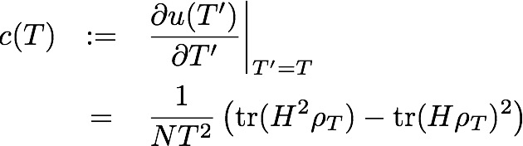
Area Law from Specific Heat
Statistical Mechanics 1.01
Gibbs state: ,
energy density:
entropy density:
Specific heat
capacity:

Slide 30


Area Law from Specific Heat
Specific heat at T close to zero:
Gapped systems:
(superconductor,
Haldane phase,
FQHE, …)
Gapless systems:
(conductor, …)

Slide 31

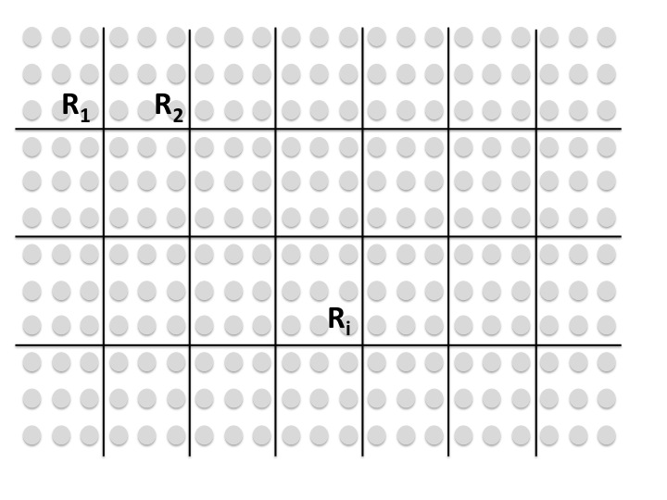
Area Law from Specific Heat
Thm Let H be a local Hamiltonian on a d-dimensional lattice Λ := [n]^{d}. Let (R₁, …, R_{N}), with N = n^{d}/l^{d}, be a partition of Λ into cubic sub-lattices of size l (and volume l^{d}).
1. Suppose c(T) ≤ T^{-ν} e^{-Δ/T} for every T ≤ T_{c}. Then for every ψ with

Slide 32
Area Law from Specific Heat
Thm Let H be a local Hamiltonian on a d-dimensional lattice Λ := [n]^{d}. Let (R₁, …, R_{N}), with N = n^{d}/l^{d}, be a partition of Λ into cubic sub-lattices of size l (and volume l^{d}).
2. Suppose c(T) ≤ T^{ν} for every T ≤ T_{c}. Then for every ψ with

Slide 33
Why?
Free energy:
Variational Principle:

Slide 34
Why?
Free energy:
Variational Principle:
Let

Slide 35
Why?
Free energy:
Variational Principle:
Let

Slide 36
Why?
Free energy:
Variational Principle:
Let
By the variational principle, for T s.t. u(T) ≤ c/l :

Slide 37
Why?
Free energy:
Variational Principle:
Let
By the variational principle, for T s.t. u(T) ≤ c/l :
Result follows from:

Slide 38
Summary and Open Questions
Summary:
Assuming the specific heat is “natural”, area law holds for
every low-energy state of gapped systems and “subvolume
law” for every low-energy state of general systems
Open questions:
Can we prove a strict area law from the assumption on c(T) ≤ T^{-ν} e^{-Δ/T} ?
Can we improve the subvolume law assuming c(T) ≤ T^{ν} ?
Are there natural systems violating one of the two conditions?
Prove area law in >1D under assumption of (i) gap (ii) finite correlation length
What else does an area law imply?

