Slide 1
Quantum Trajectories - ”revisiting the past” IICQI-14, Isfahan, 2014.
Theory: ”Past quantum states”, Phys. Rev. Lett. 111, 170401 (2013)
Søren Gammelmark, Brian Julsgaard, Klaus Mølmer Examples:
Experiments by
Serge Haroche, Paris, Dieter Meschede, Bonn;
Kater Murch, St. Louis/Irfan Siddiqi, Berkeley.

Slide 2
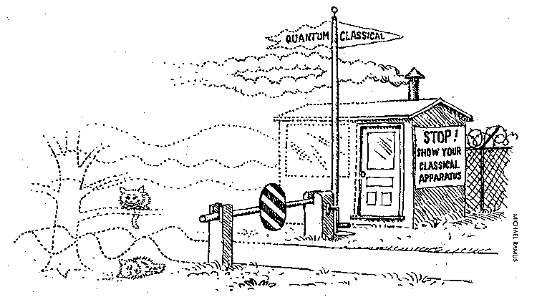
Evolution of quantum systems
Input, driving
Output, probing
Measurements on a quantum system imply
- wave function collapse - back action - state reduction
This conditional time evolution is
non-unitary, non-linear, non-local,
unpredictable, counter-intuitive,
… indispensable to describe repeated/continuous measurements

Slide 3
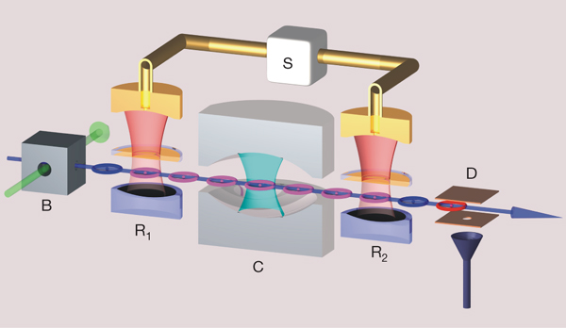
Probed quantum systems: two examples
If the emission is detected, the
atom jumps into the ground state
Monte Carlo Wave Functions
(J. Dalibard, Y. Castin, KM, 1991)
Exponential decay,
Master Equation for ρ(t)
Atomic transmission probing (ENS):
General measurements:
probe outcome m → Ω_{m}
|ψ> → Ω_{m} |ψ>
Repeated measurements: a quantum trajectory
p(n)
p_{cond}(n)

Slide 4
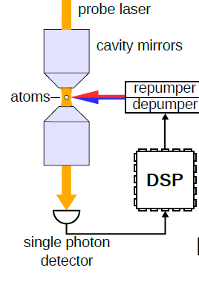
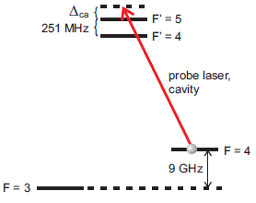
Probed quantum systems: two examples
Optical transmission probing (Bonn):
Atomic transmission probing (ENS):
Ω_{m}
<m| U_{S+P} |φ_{P}>|ψ>
| U_{S+P} |φ_{P}>|ψ>
|φ_{P}>|ψ>
ψ>
General measurements:
probe outcome m → Ω_{m}
|ψ> → Ω_{m} |ψ>

Slide 5
”Can Quantum-Mechanical Description of
Physical Reality be Considered Complete?” A. Einstein, B Podolsky, N Rosen,
Phys. Rev. 47, 777-780 (1935)
”|ψ> → Ω_{m} |ψ> implies
spooky action at a distance”
”Can Quantum-Mechanical Description of Physical Reality be Considered Complete?” N. Bohr, Phys. Rev. 48, 696-702 (1935)
” …not a mechanical influence …
… an influence on the very conditions which define the possible types of predictions regarding the future behavior of the system.”

Slide 6
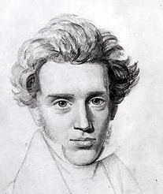
An influence on ψ or ρ is an influence on
” … the very conditions which define
the possible types of predictions regarding
the future behavior of the system.”
Do I, at time T, know more about the past state at time t,
than I already did at that time t ?
“Life can only be understood backwards; but it must be
lived forwards."
Søren Kierkegaard
1813-1855

Slide 7
By the (past) quantum state, I will refer to …
Do measurements cause ”spooky action in the past” ?
” … the very conditions which define
the possible types of predictions regarding
the future behavior of the system.”
”the state” = our description of the state = our ”knowledge”
How are these ”conditions” determined and represented ?
How do we verify predictions about the past ?
For what purposes may past knowledge be applied ?

Slide 8
Classical example: ”Where are my car keys ?”
Having found the keys, at time T,
I know precisely where they were at time t !
Non trivial prediction and verification:
where did my wife see our car keys at time t ?
Now, replace ”keys” by”cat” → non-trivial dynamics !

Slide 9
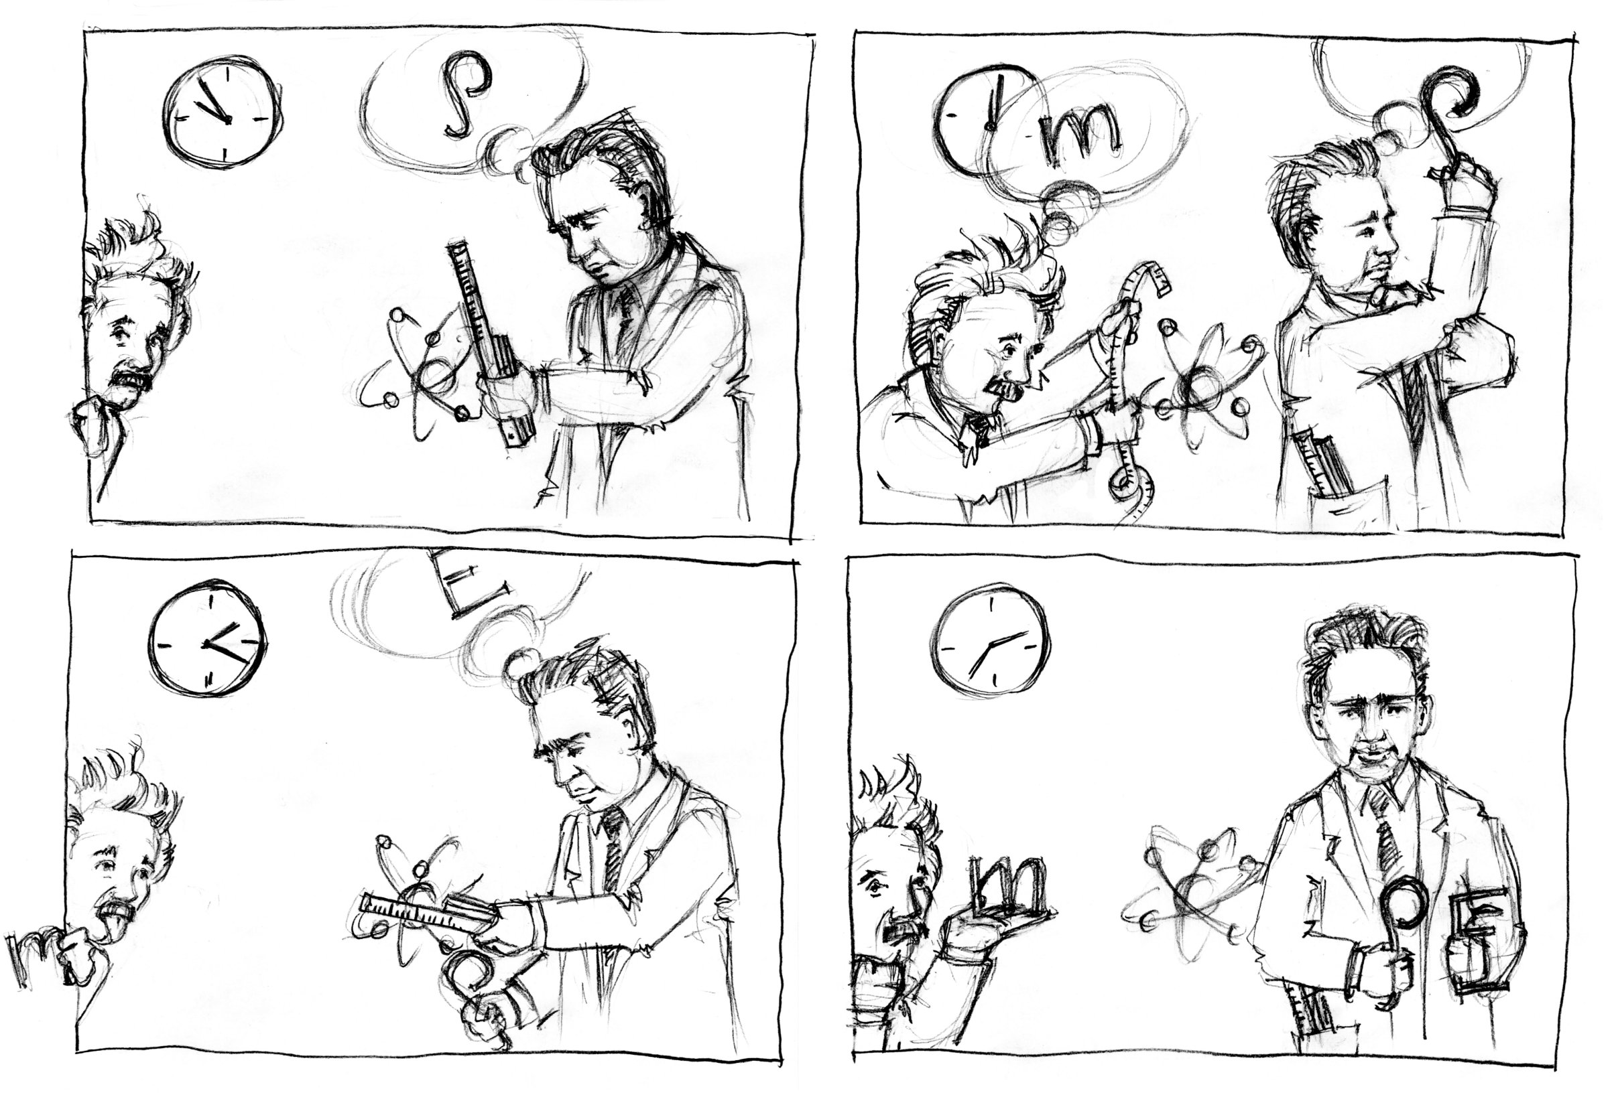
Ill. Sidse Damgaard Hansen

Slide 10
Ill. Sidse Damgaard Hansen
?

Slide 11
Past quantum state - definition
time t
Any - strong or weak - measurement of any observable, can be
implemented by coupling to - and projective read-out of - a meter system.
time t

Slide 12
Past quantum state - definition
Any - strong or weak - measurement of any observable, can be
implemented by coupling to - and projective read-out of - a meter system.
M₁
M₂
M_{N}

Slide 13
Past quantum state – heuristic derivation
M₁
M₂
M_{N}
p(m) =Tr(
|m><m| U(ρ |i><i|)U⁺ |m><m|
)
=Tr(
)
Ω_{m} ρ Ω_{m}⁺
→ Tr(
)
(|m><m|)M_{N} … M₂ M₁ U(ρ |i><i|)U⁺ M₁⁺ M₂⁺ … M_{N}⁺(|m><m|)
=Tr(
)
M_{N} … M₂ M₁(|m><m|) U(ρ |i><i|)U⁺ (|m><m|) M₁⁺ M₂⁺ … M_{N}⁺
=Tr(
)
(|m><m|) U(ρ |i><i|)U⁺ (|m><m|) M₁⁺ M₂⁺ … M_{N}⁺ M_{N} … M₂ M₁
=Tr(
)
I
Ω_{m} ρ Ω_{m}⁺ E
E(t) solves adjoint, backwards SME

Slide 14
Past quantum state - consistent definition
ρ(t) solution to SME
E(t) solution to adjoint SME

Slide 15
Ill. Sidse Damgaard Hansen

Slide 16
Analysis of photon counting experiments (Bonn)
S. Gammelmark, et al, Phys. Rev. A 89, 043839 (2014)
.
Two effects: ”improve signal-to-noise”
”do not overreact on spikes”

Slide 17
Analysis of a simulated ENS experiment
Simulated field dynamics and atom detection
p(n=1)
Usual Bayes:
”If the photon number is odd, it is most likely 1.”
”If the photon number is even, it is most likely 0.”
In Hindsight:
”If the photon number is even for only a very
short time, it is probably 2 rather than 0.”
p(n=2) !!!

Slide 18
Analysis of a real ENS experiment
Published in
Nature 448, 889, (2007)
What really happened
Igor Dotsenko, 2013

Slide 19
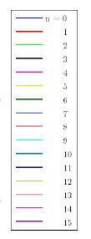
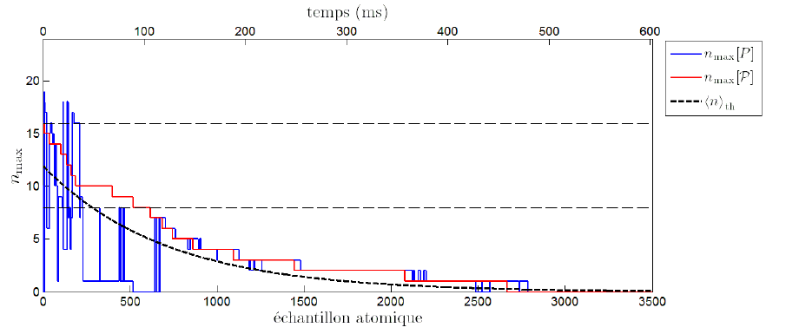
New ENS experiment (arXiv:1409.0958)
Is it n or n+8 ?
In hindsight
we know for sure !

Slide 20
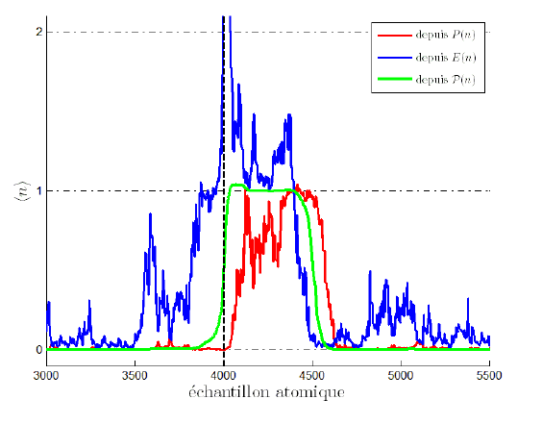
New ENS experiment (arXiv:1409.0958)
When do the jumps occur ?
Red: ρ - we learn ”too late”
Blue: E - pure retrodiction
Green: the combined ρ and E

Slide 21
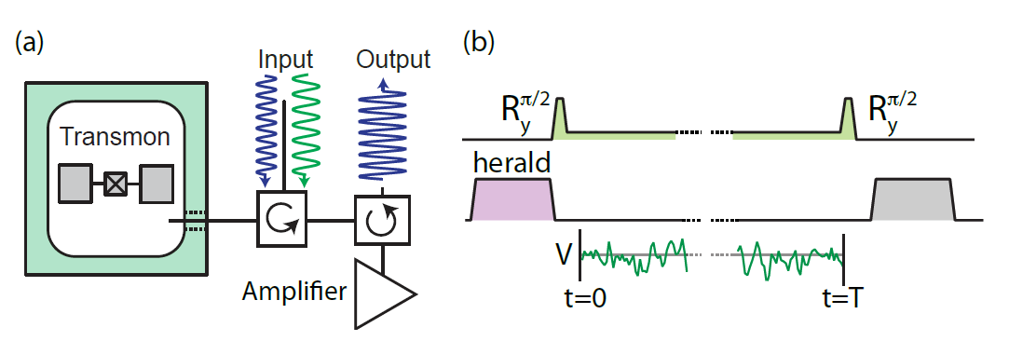
Monitoring a superconducting qubit (D. Tan er al, arXiv:1409.0510)
Signal amplitude ~ σ_{z}
← Prediction of final readout
← Retrodiction of the herald

Slide 22
Past quantum state prediction

Slide 23
Summary
The state of a quantum system is conditioned on the outcome of probing measurements.
States in the past are (now) conditioned on measurements until the present → the past quantum state.
Past states make more accurate predictions, e.g., for:
state assignment, guessing games, parameter estimation
Natural quantum extension of classical Bayes theory: ”smoothing”.
Natural generalization* of Aharonov-Bergmann-Lebowitz-rule, ”weak value measurements” with pre- and post selection, Leggett-Garg inequality, counterfactual paradoxes, …
(*: allows general dynamics, and general measurements)
Ref.: Gammelmark, Julsgaard,, and KM, ”Past quantum states”, Phys. Rev. Lett. 111 (2013)

Slide 24
What is a quantum state ?
Ψ, ρ ?
Ψ, ρ ?
Ψ(t), ρ(t) →
ρ(t), E(t)
Is the past
quantum state

Slide 25
I hope you will be looking
backward to this talk ;-)

