Slide 1


Minimising the heat dissipation of information erasure
M. Hamed Mohammady
IT, Lisbon
IICQI 2014, Esfehan

Slide 2
Overview
Landauer’s principle in quantum mechanics
Example: Maximal bit erasure with minimal heat dissipation within Landauer's framework
Information erasure beyond Landauer

Slide 3





Information erasure costs energy

Slide 4

Information erasure costs energy

Slide 5
Landauer’s principle in Quantum Mechanics

Slide 6

Basic assumptions

Slide 7

Improved Landauer’s inequality
(Reeb and Wolf arXiv:1306.4352)

Slide 8

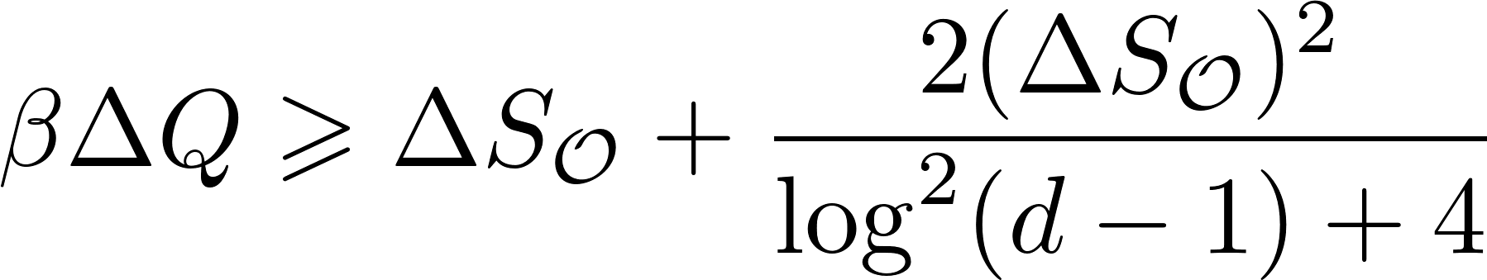
Improved Landauer’s inequality
(Reeb and Wolf arXiv:1306.4352)

Slide 9
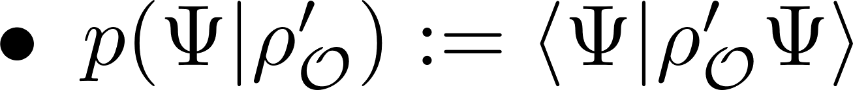
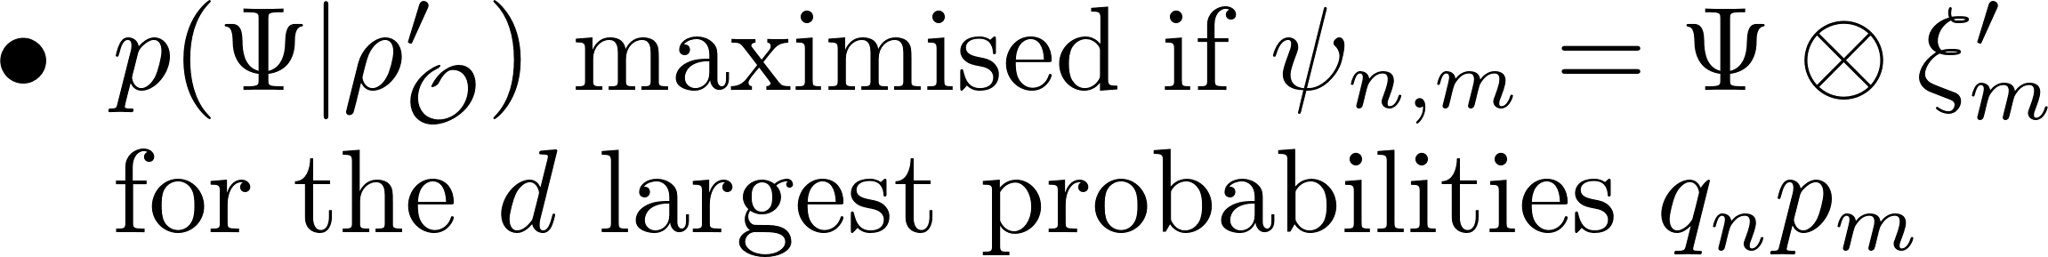
Restrict task to maximal information erasure with minimal heat dissipation

Slide 10
Example: Maximal bit erasure with minimal heat dissipation within Landauer's framework

Slide 11
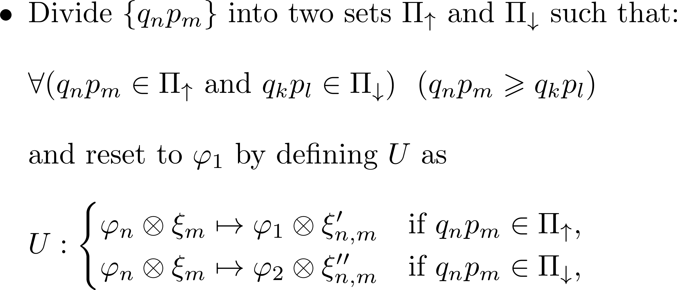
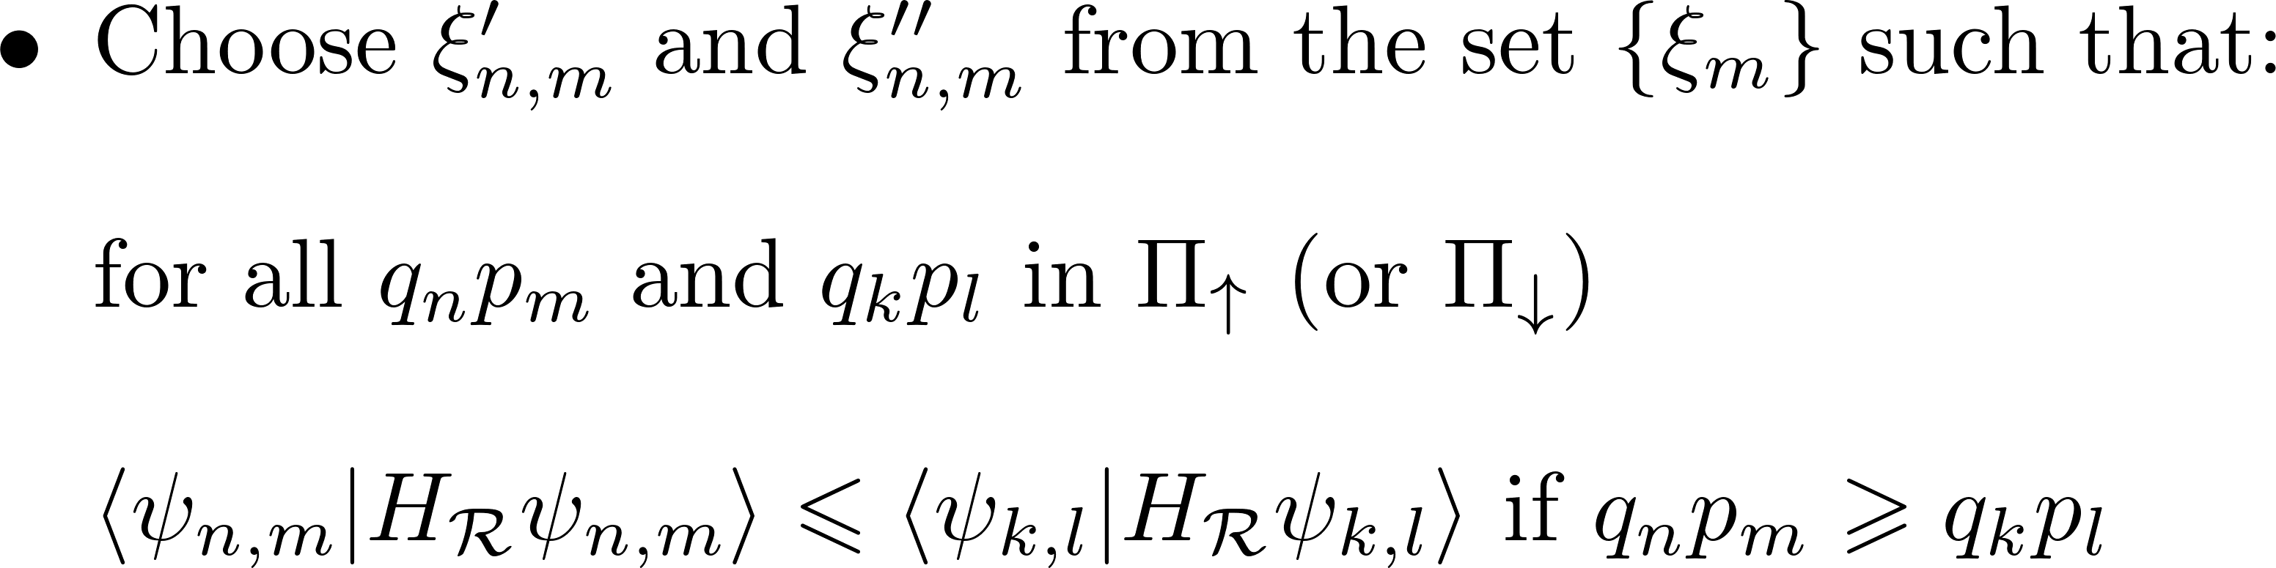
The optimal unitary operator for bit erasure

Slide 12
Bit erasure with Swaps is sub-optimal

Slide 13
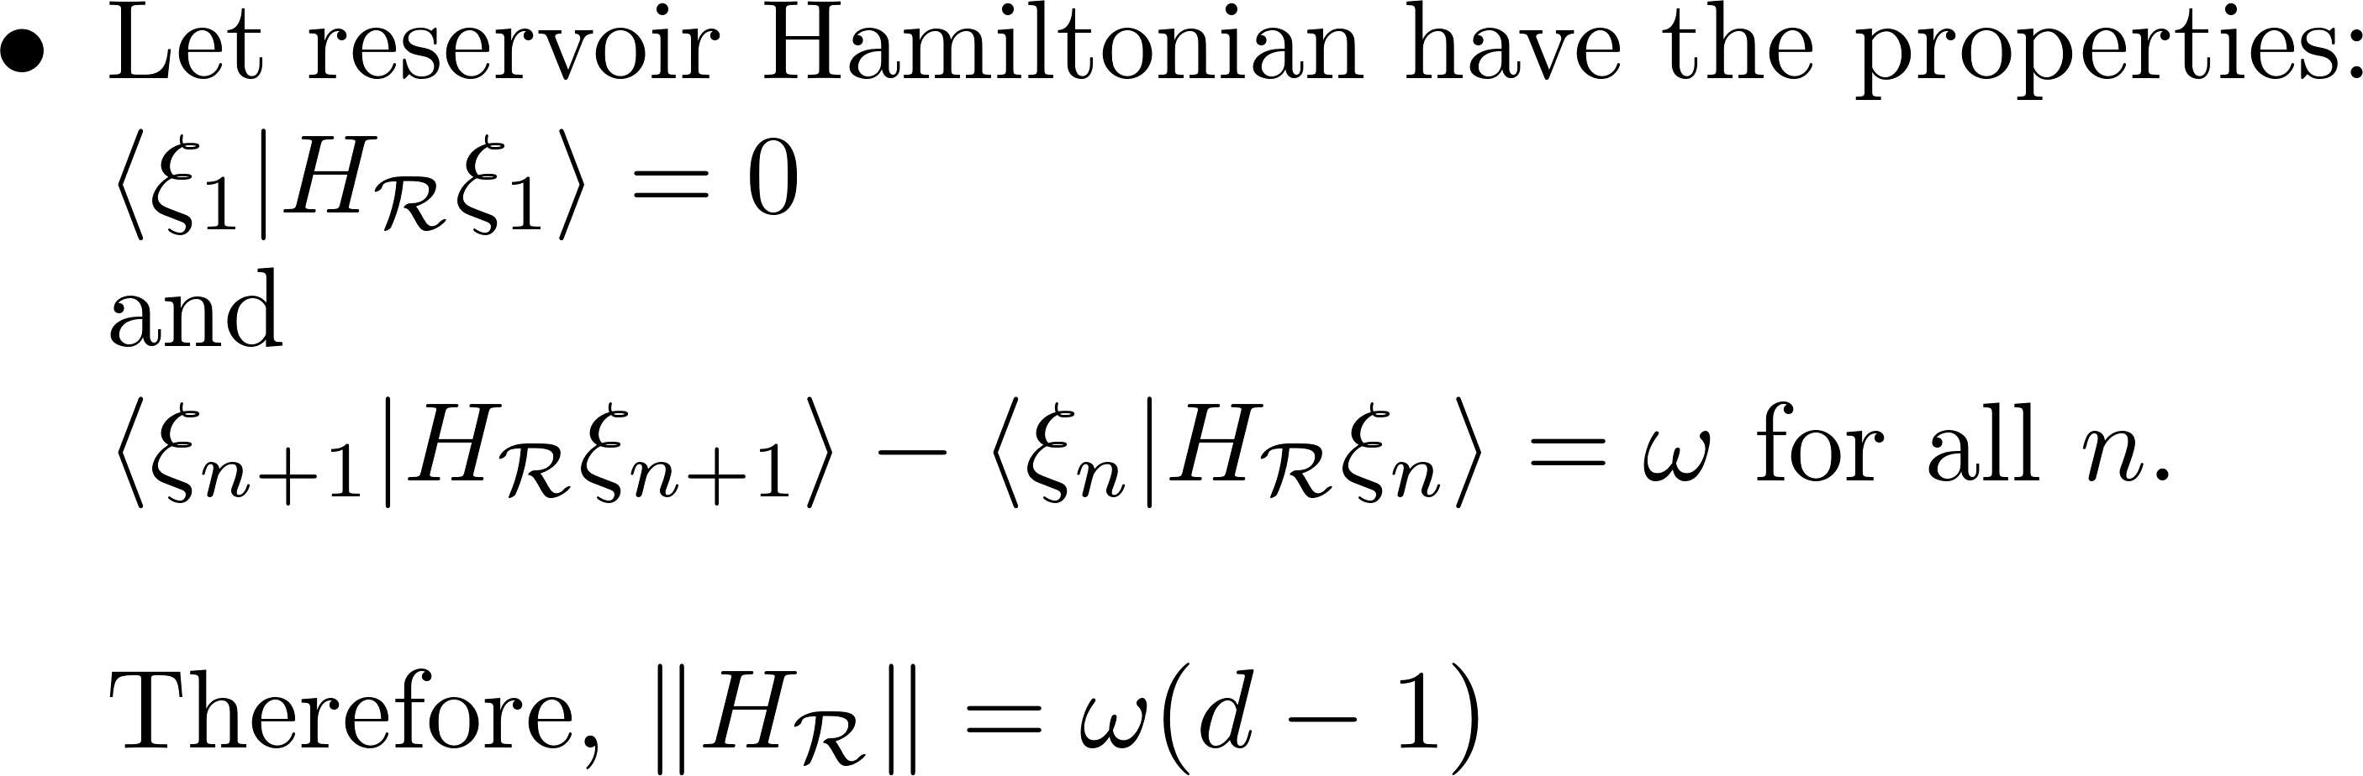
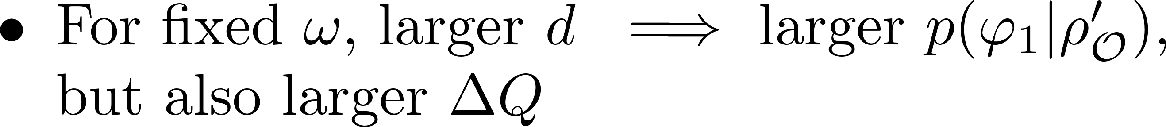
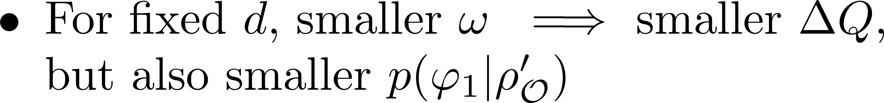
Bit erasure using first d levels of a harmonic oscillator of frequency ω

Slide 14
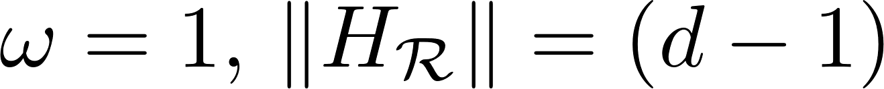
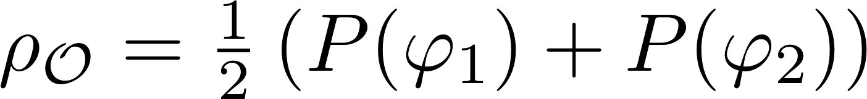
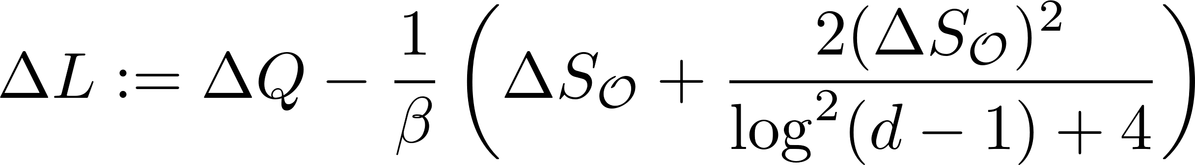

Slide 15
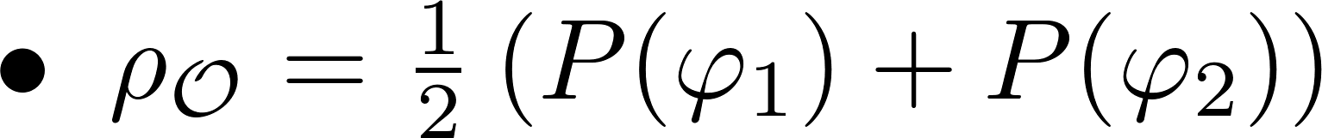
Optimal case for maximally mixed qubit is greater than Landauer’s bound

Slide 16
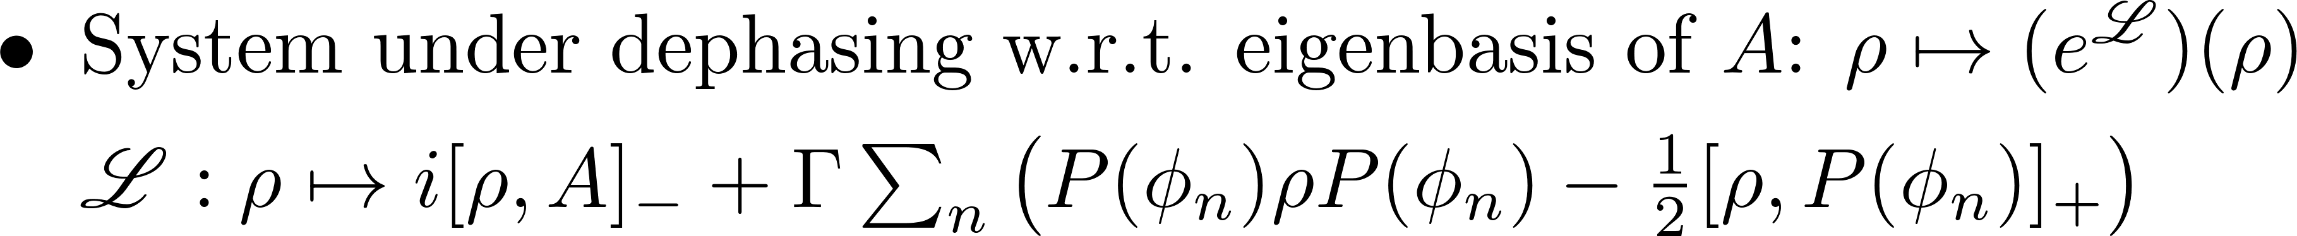
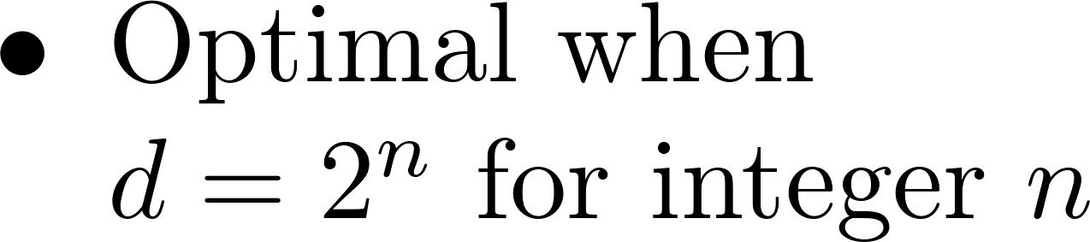
Robustness to Markovian dephasing

Slide 17
Information Erasure Beyond Landauer

Slide 18


Change the conceptual framework

Slide 19

Object, auxiliary and reservoir

Slide 20

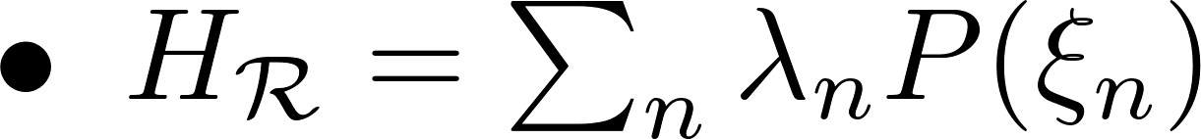
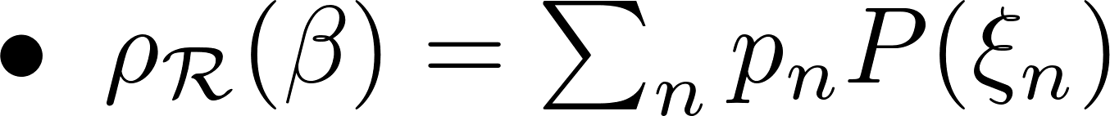
Object as subsystem of reservoir

Slide 21
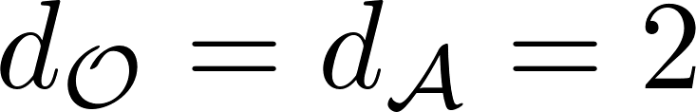
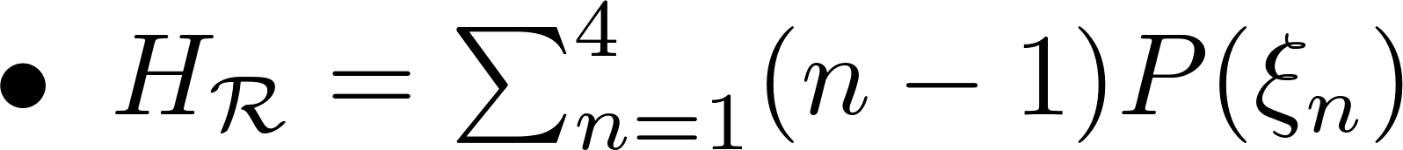

Slide 22
Conclusions
Maximal information erasure with minimal heat dissipation, within Landauer’s framework, achieved by a permutation operation.
For a reservoir composed of a harmonic oscillator, minimal heat dissipation of bit erasure achieved is the temperature of the reservoir, when the frequency is vanishingly small.
Correlations between object and auxiliary system unimportant; only rank affects efficacy of information erasure.
If object is a subsystem of a thermal reservoir, optimal heat dissipation achieved when eigenvectors of the reservoir Hamiltonian are product vectors.

Slide 23







Physics of Information Group, Lisbon

