Slide 1
On Measuring Coherence in Coupled Dangling-Bond Pair Dynamics
In the Name of God
Zahra Shaterzadeh-Yazdi
International Iran Conference on
Quantum Information 2014
09 September 2014

Slide 2






NINT
  Characterizing the rate and coherence of single-electron tunnelling between two dangling bonds on the surface of silicon Z. Shaterzadeh-Yazdi, L. Livadaru, M. Taucer, J. Slater, J. Pitters,
  R. Wolkow, B. Sanders
  Physical Review B, 89, 035315 (2014)

Slide 3
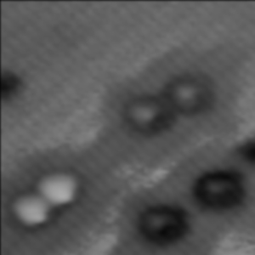
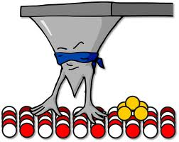

Outline
  Introduction: what is a dangling bond (DB)?
  Motivation: why studying coupled-DB pairs?
  On measuring coherence in
  dangling-bond pair dynamics
  Results
  Summary and future direction
e
e

Slide 4
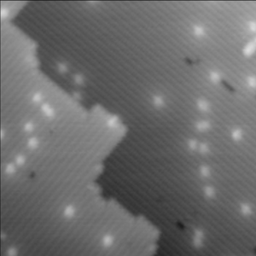
  What is a Dangling Bond?

Slide 5
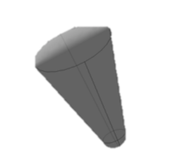
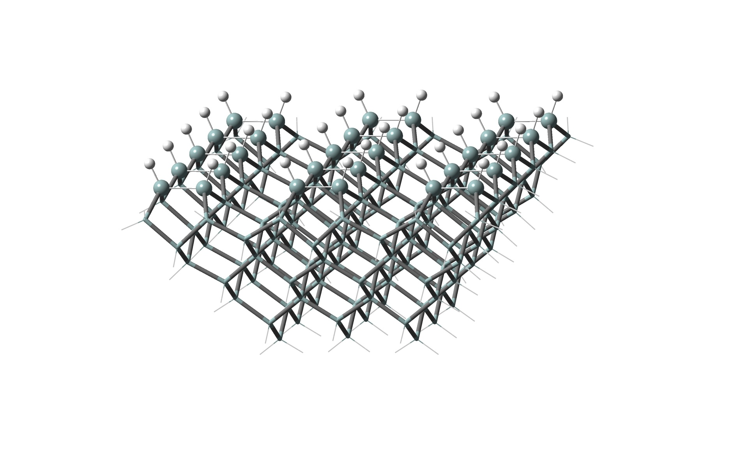
Dangling Bond on H-Si(100)-2x1 Surface
DB
p
Si-Si Dimer
P
P
DB
1/7

Slide 6
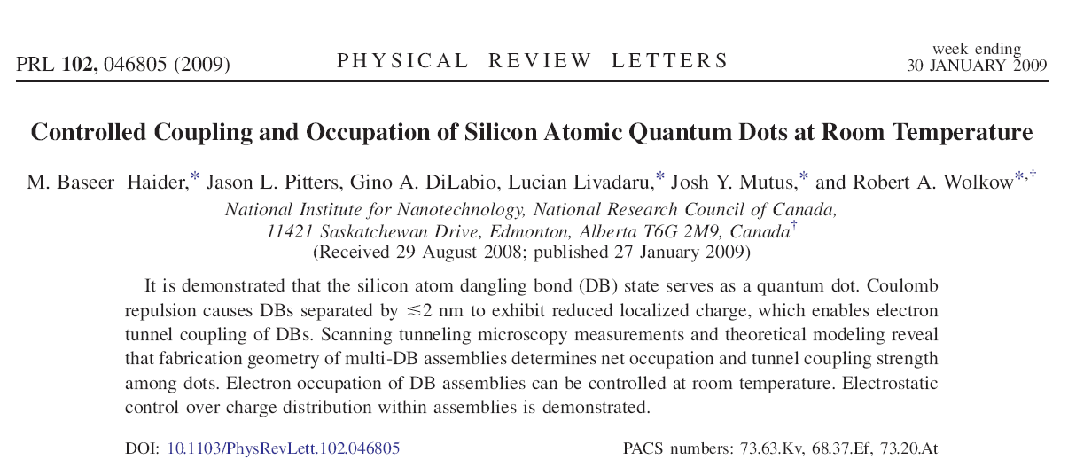
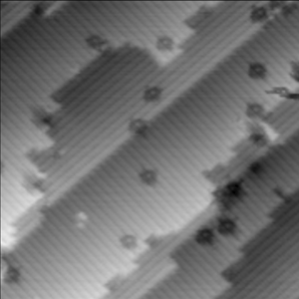
A Surface DB as a Quantum Dot
2/7

Slide 7
Motivation: Why Studying Coupled-DB Pairs?
DBP⁻ as a dynamic-charge defect for Si-based electronic devices
DBP⁻ and functionality of the Si surface: its effect on bonding of the
atomic and molecular species on the Si surface
DBP⁻ as a potential candidate for charge qubit or an intercessor for
spin-qubit measurement in quantum computation
Developing an understanding of the coherence and bonding of coupled dangling-bond pairs on H-Si(100)-2x1 surface
3/7

Slide 8
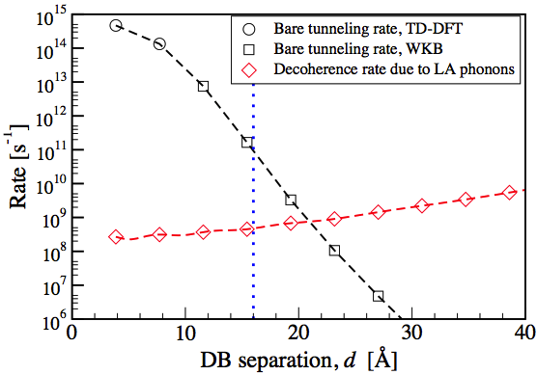
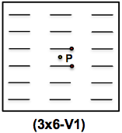
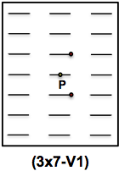
DBP⁻
  Dangling-bond charge qubit on a silicon surface
  New Journal of Physics 12, 083018 (2010)
4/7

Slide 9
  On Measuring Coherence in
  Coupled Dangling-Bond Pair Dynamics
e
e

Slide 10
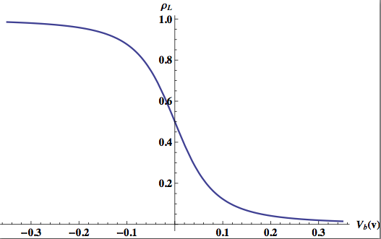


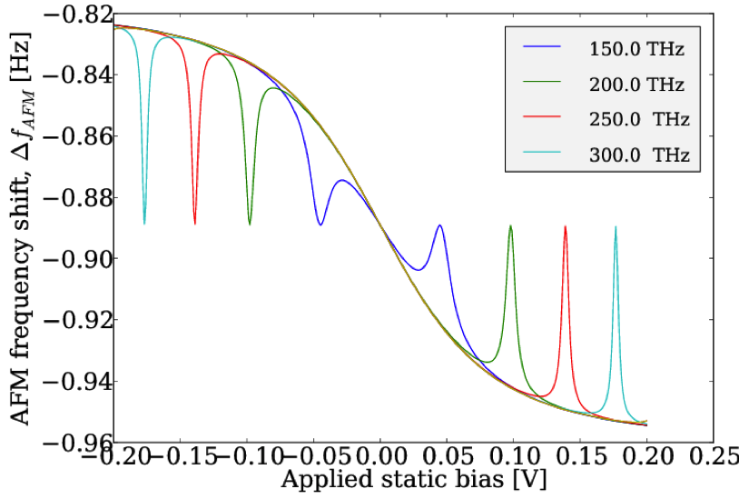


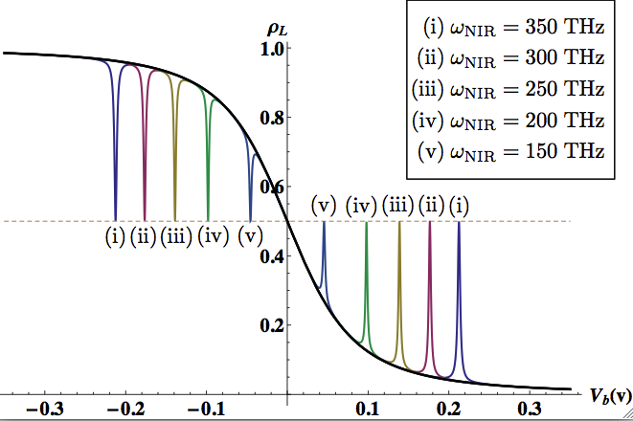


Effect of applied bias
Atomic Force Microscope
AFM
&
L
MIR field
e
R
Effect of MIR driving field
5/7

Slide 11
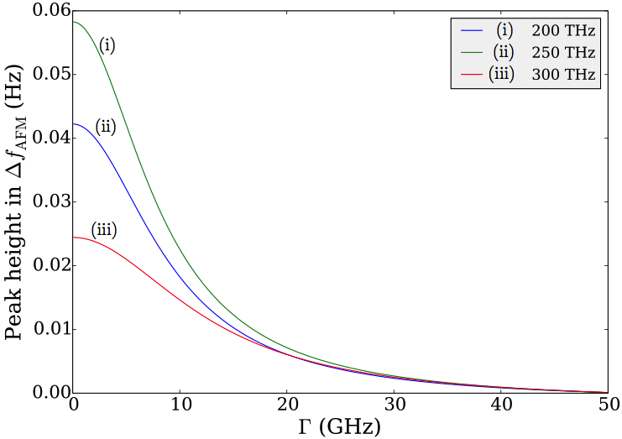
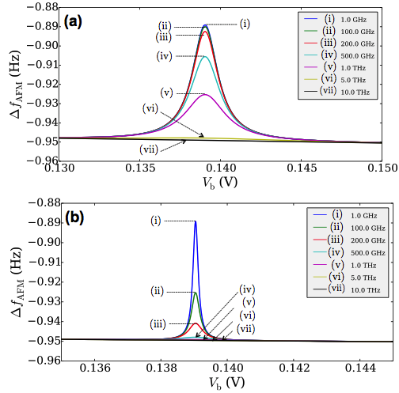
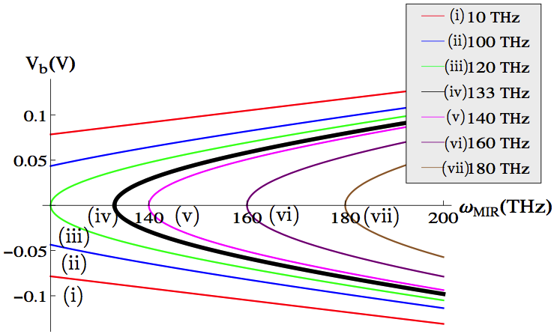
Extracting DBP⁻ Tunneling and Decoherence Rates
6/7

Slide 12
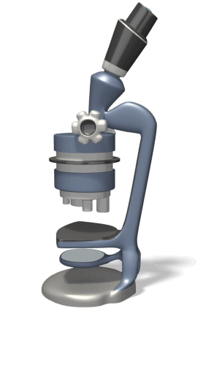
Summary and Future Work
e
e
V
  Z. Shaterzadeh-Yazdi et al. Phys. Rev. B, 89, 035315 (2014)
e
MIR field
e
v
7/7

Slide 13

  Thanks for Your Attention

